Slide 1
Marketing and Retail Analytics Milestone – 2 Project
Swaathi Ramakrishnan
PGP-DSBA - May ‘22

Slide 2
Contents
Problem Statement
Executive Summary of the data
Exploratory Data Analysis
Exploratory Data Analysis - Trends
Exploratory Data Analysis(Inferences)
Market Basket Analysis
KNIME Workflow Image
Associations and Recommendations (A suggestion of Possible Combos with Lucrative Offers)
Working Files

Slide 3
Problem Statement
A Grocery Store shared the transactional data with you. Your job is to identify the most popular combos that can be suggested to the Grocery Store chain after a thorough analysis of the most commonly occurring sets of menu items in the customer orders. The Store doesn’t have any combo meals. Can you suggest the best combo meals?
Excel Column Name | Definition
Date | Order Number
Order_id | Quantity Ordered
Product | Price of Each Item

Slide 4
Executive Summary of the data
Shape of the Data
3 columns, 20641 rows
Nulls in Data
0
Duplicates in Data
4730
Data Types in Data
Date time: 1
Numeric: 1
Object: 1

Slide 5
Executive Summary of the data (continued)
The data looks accurate since there are no nulls
There are 4730 duplicate records, but since we don’t have any other sales information we can assume that duplicate product records indicate multiple quantities bought or variation of products under the product group.
Duplicate records won’t affect Market Basket Analysis as we will be considering only unique products under each basket, in this scenario order_id.
Performed univariate, bivariate and multivariate analysis on the data.
Order date information gives us monthly, quarterly and yearly trends on number of orders and products chosen by customers.
We have data to perform Market Basket Analysis and derive association rules.

Slide 6

Exploratory Data Analysis Univariate Analysis
Date column ranges from 2018-01-01 to 2020-12-02. Highest frequency in date column is 2019-08-02 with 183 occurrences.
Order_id, though an integer column, is a nominal column. Order id ranges from 1 to 1139.
Product is an object column, and the dataset consists of 37 unique products. Poultry has the highest frequency of 640 occurrences and seems to be the favorite product among the customer transactions.

Slide 7
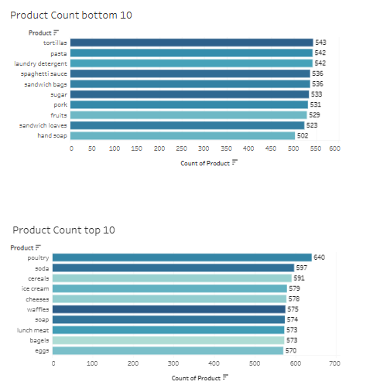
Exploratory Data Analysis Univariate Analysis
Poultry is the product with highest frequency among the products in the dataset at 640
Product with least frequency is “Hand soap” with 502
The percentage difference between the lowest 502 and highest frequency, 640 is 138 over a period of 3 years from Jan-2018 to Dec-2020.

Slide 8
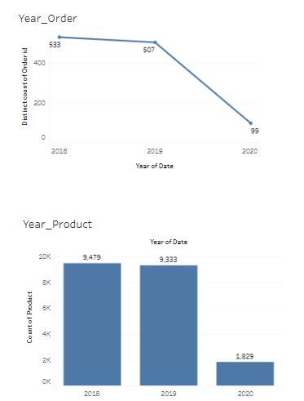
Exploratory Data Analysis Bivariate Analysis - Yearly Trend Analysis
Derived the number of orders and products ordered across the years
In 2018 we have the number of product count at 9479 which decreases to 9333 in 2019 and then to 1829 in 2020
In 2018 we have the number of orders at 533 which decreases to 507 in 2019 and then to 99 in 2020

Slide 9
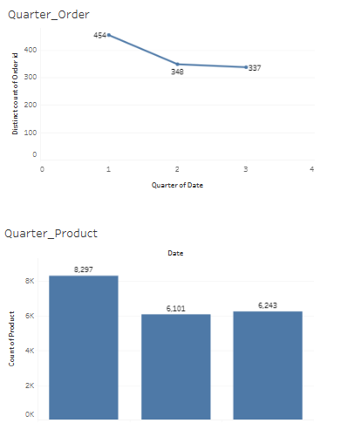
Exploratory Data Analysis Quarterly Trend Analysis
Derived the number of orders and products ordered across the quarters
In Q1 we have the number of product count at 8297 which decreases to 6101 in Q2 and then increases to 6243 in Q3. For Q4 we do not have data
In Q1 we have the number of orders at 454 which decreases to 348 in Q2 and then increases to 337 in Q3. For Q4 we do not have data

Slide 10
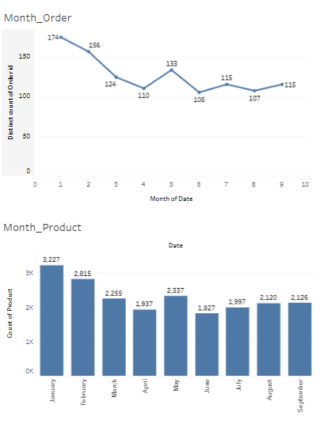
Exploratory Data Analysis Monthly Trend Analysis
Derived the number of orders and products ordered across the months
There is a decrease in trend monthly. We can see we have no data for October, November and December

Slide 11
Exploratory Data Analysis Inferences
The transaction dataset consists of 20641 product level transactions.
The transactions range from 2018-01-01 to 2020-12-02.
Order id ranges from 1 to 1139.
There are 37 unique product groups in the given dataset.
We can see that both number of orders and number of product types ordered progressively reducing across the years from 2018 to 2020.
2018 and 2019 orders show a seasonality where Q2 and Q3 orders and number of products ordered have reduced considerably when compared to Q1.
2020 is a lean period where business seems to be struggling with overall orders and number of product types in orders.
We can see that product count is lowest in months of April and June. The trend shows that max product count in Jan which declines until April, then follows a small rise across May and falls slightly until September and then NIL in October to December.

Slide 12
Market Basket Analysis (MBA)
What is Market Basket Analysis?
Market Basket Analysis is a technique to identify patterns in the purchases of customers in any retail setting.
The technique attempts to identify relationship among items in each customer’s order purchase and quantitatively group items which are highly correlated from a purchase perspective.
For example a person who purchases bread is more likely to buy jam than deodorant. So MBA will quantitatively establish that there is a relationship between bread and jam than bread and deodorant.
Market basket analysis is modeled on Association rule mining, which goes as per the if- then construct, which is represented as, IF customer buys bread THEN he is likely to buy jam as well.
MBA helps to optimize operations in the store and optimal placement of goods with high relationship.
It helps to understand customer’s behavior and purchase patterns thus helping with individual promotions/suggestions.

Slide 13
Market Basket Analysis (MBA) – Association Rules
In this given dataset we can see that business is dwindling in the year 2020. We can use MBA on the given dataset and understand the association that exists between different purchase items. This will help customer to provide combo offers and subsequently lead to rise in sales.
Let us consider an association rule which says {A} -> {B}, i.e. IF ‘A’ THEN ‘B’
The 3 main metrics in association data mining are as follows:
Support – This is the ratio of transactions involving A to the total number of transactions. This metric is important as it identifies the item most involved in transactions that could lead to a greater impact.
Confidence – This indicates the percentage of time B was purchased given A. This value ranges from 0 to 1 and indicates the confidence of the rule. i.e. a confidence level of 0.75 in {A} -> {B}, tells us that in 75% of the cases when ‘A’ occurred, ‘B’ also occurred.
Lift – This indicates the increase in sale of ‘A’, given ‘B’. Lift is derived as Confidence/Support for B. This valu indicates the likeliness of ‘A’ and ‘B’ occurring together. If lift value is greater than 1, it indicates positive correlation between A and B and hence its likely that ‘A’ and ‘B’ will occur together and if lift is lesser than 1, its unlikely that ‘A’ and ‘B’ occurs together.

Slide 14
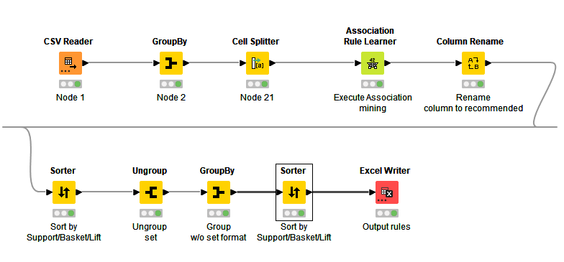
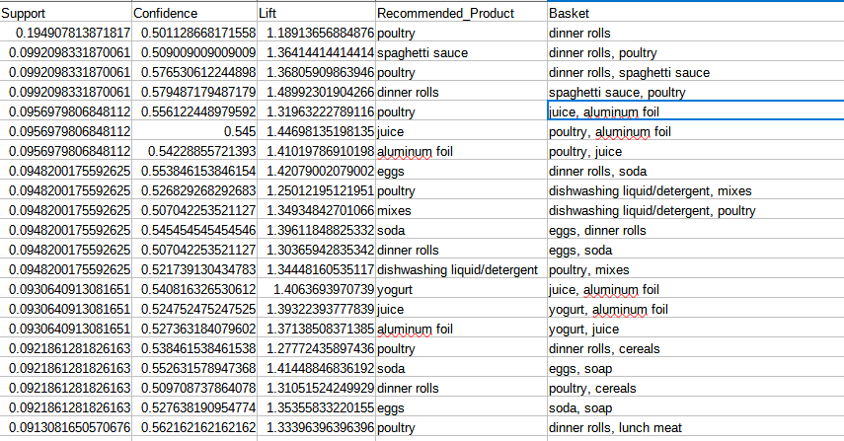
KNIME Workflow
On running the workflow, the output data with association rules are generated and a screenshot is attached below.
When running MBA on the given dataset the threshold set for Support and confidence are :
Support – 0.05. We will look at basket combination which exists at least 5% of the orders. This will give us association rules for pretty much all the 37 unique product combinations customers have been placing order on.
Confidence – 0.5. We have set confidence at 50% level as we want to identify rules where the association exists in at least 50% of the order id’s, so that implementation of the rule will have an impact.

Slide 15
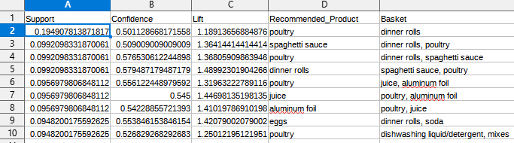
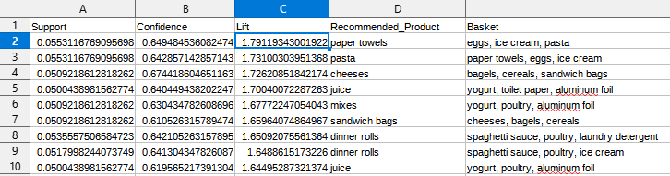
Association and Recommendation
The MBA analysis on the given dataset with thresholds of Support(0.05) and confidence 0.5 has yielded 1109 association rules.
Rules with high support
Rules with high lift

Slide 16

Association & Recommendation (continued)
High support indicates the likelihood of the rule being enforced and high lift indicates the increase in sales of the basket w.r.t recommended product.
Rules with high support
From row 1 we can see that there is 19.5% chance that a customer buys dinner rolls and the recommended product is poultry with lift 1.18, i.e. likelihood is high. So we should have some discount on poultry for customers who buy dinner rolls alone.
Similarly, the next three rows gives associations, such as:
basket {dinner rolls, poultry} recommendation is spaghetti sauce
basket {dinner rolls, spaghetti sauce} recommendation is poultry
basket {spaghetti sauce, poultry} recommendation is dinner rolls
Considering the scenarios, a combo deal for dinner rolls, spaghetti sauce & poultry in the form of a % off or in the form of ‘Buy 2 Get 1 Free’ should increase the sales. The appropriate campaign can be decided based on price and margin on the items.

Slide 17
Association & Recommendation (continued)
Similarly, from the next 3 row of highest support we can see that poultry, aluminum foil and juice has interdependent association rules.
Considering the scenarios, a combo deal for poultry, aluminum foil and juice in the form of a percentage off or in the form of buy 2 each and get one free should increase the sales. The appropriate campaign can be decided based on price and margin on the items.
Higher lift indicates that sale of recommended product will increase the sales of the basket. Since lift considers confidence of rule among the overall dataset, it can provide good insights. Lets take a look at some of the first rows:
We can see association rule {eggs,ice cream,pasta} -> {paper towels}, hence this recommendation can be suggested with customers having basket of eggs, ice cream pasta. Similarly the case for {paper towels, eggs, ice cream} -> {pasta}.
Considering the scenarios, a combo deal for paper towels, eggs, ice cream & pasta in the form of a percentage off or in the form of buy 3 and get one free should increase the sales. The appropriate campaign can be decided based on price and margin of the items involved.
Similarly, we can see the rows 12 and 13 where eggs, Paper towels, dinner rolls and pasta have interdependent association rules.
Considering the scenarios, a combo deal for eggs, paper towels, dinner rolls and pasta in the form of a percentage off or in the form of buy 2 each and get one free should increase the sales. The appropriate campaign can be decided based on price and margin on the items.
Similarly, we can have many more associations and combo items generated from the association rules.

Slide 18
Working Files
Analyzed the data using python, KNIME and Tableau
The link for the Tableau workbook:
https://public.tableau.com/app/profile/swaathi.ramakrishnan/viz/SwaathiRamakrishnanMRA_Milestone_2/MRA_Milestone2_EDA?publish=yes
The Jupyter(python) notebook and KNIME workflow is attached along with this powerpoint presentation for submission.
Association Dataset is attached in the project submission

